Slide 1
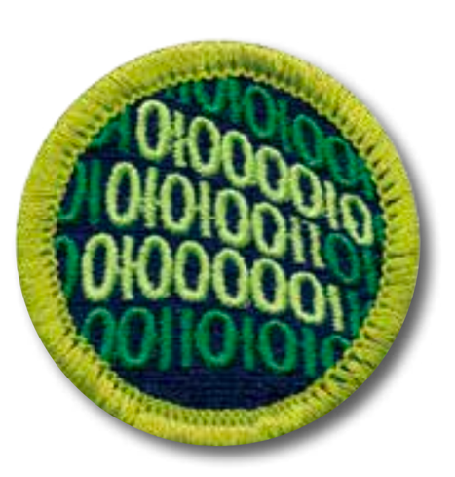
Programming Merit Badge
October 2022
Mark Rowland
Abhishek Pillai
Heather Meiring
Raja Vellanki
Robert Baker
Jean-Etienne Poirier
This presentation (except parts taken from other, referenced work) is licensed under a Creative Common Attribution-ShareAlike 4.0 International License
Notes:
Ask who already programmed – just to gauge the audience

Slide 2
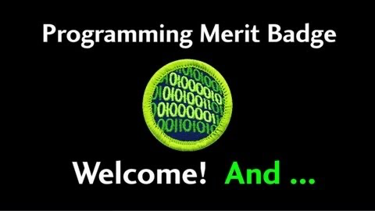

Slide 3
Requirements
1. Safety.
Do the following:
a. Show your counselor your current, up-to-date Cyber Chip.
b. Discuss first aid and prevention for potential injuries, such as eyestrain and repetitive stress injuries, that could occur during programming activities.
2. History. Do the following:
a. Discuss with your counselor the history of programming and programming languages, and discuss how programming languages have evolved over time to become easier to use while adding additional capabilities.
b. Discuss with your counselor the history of programming and the evolution of programming languages.

Slide 4
Requirements
3. General knowledge. Do the following:
a. Create a list of 10 popular programming languages in use today and describe which industry or industries they are primarily used in and why.
b. Describe three different programmed devices you rely on every day.
4. Intellectual property. Do the following:
a. Explain the four types of intellectual property used to protect computer programs.
b. Describe the difference between licensing and owning software
c. Describe the differences between freeware, open source, and commercial software, and why it is important to respect the terms of use of each.

Slide 5
Requirements
5. Projects. Do the following:
a. With your counselor’s approval, choose a sample program. Modify the code or add a function or subroutine to it. Debug and demonstrate the modified program to your counselor.
b. With your counselor’s approval, choose a second programming language and development environment, different from those used for requirement 5a and in a different industry from 5a. Then write, debug, and demonstrate a functioning program to your counselor, using that language and environment.
c. With your counselor’s approval, choose a third programming language and development environment, different from those used for requirements 5a and 5b and in a different industry from 5a or 5b. Then write, debug, and demonstrate a functioning program to your counselor, using that language and environment.
d. Explain how the programs you wrote for requirements 5a, 5b, and 5c process inputs, how they make decisions based on those inputs, and how they provide outputs based on the decision making.

Slide 6
Requirements
6. Careers
Find out about three career opportunities that require knowledge in programming. Pick one and find out the education, training, and experience required. Discuss this with your counselor and explain why this career might be of interest to you

Slide 7
Safety
Do the following:
a. Show your counselor your current, up-to-date Cyber Chip.
b. Discuss first aid and prevention for potential injuries, such as eyestrain and repetitive stress injuries, that could occur during programming activities.

Slide 8
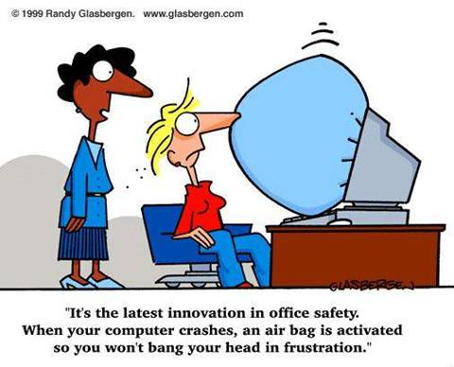

Slide 9


Slide 10
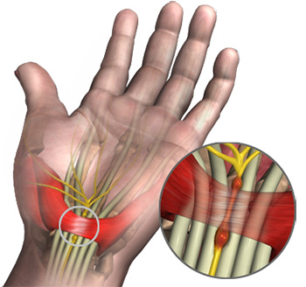
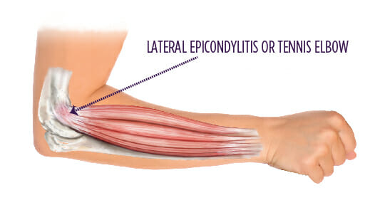
RSIs - Repetitive Stress Injuries
Carpal tunnel syndrome
Cervical radiculopathy
Complex regional pain syndrome
Tendonitis
Notes:
Carpal tunnel syndrome (CTS) occurs when the median nerve, which runs from the forearm into the palm of the hand, becomes pressed or squeezed at the wrist. The carpal tunnel—a narrow, rigid passageway of ligament and bones at the base of the hand—houses the median nerve and the tendons that bend the fingers.
Cervical radiculopathy signs and symptoms typically include pins-and-needles tingling, numbness, and/or weakness in the areas served by the affected nerve root. In addition to these neurological deficits, pain is also present in most cases.
Complex regional pain syndrome (CRPS) is a broad term describing excess and prolonged pain and inflammation that follows an injury to an arm or leg.
Tendinitis is inflammation or irritation of a tendon — the thick fibrous cords that attach muscle to bone. The condition causes pain and tenderness just outside a joint. While tendinitis can occur in any of your tendons, it's most common around your shoulders, elbows, wrists, knees and heels.

Slide 11
First Aid for RSIs
Apply an ice pack to the injured area to help reduce pain and swelling
Use an elastic joint support or wrap the area firmly with an elastic bandage to limit the swelling and to protect the injury. Do not wrap it so tightly that blood circulation is restricted!
Rest the injured area
Take an anti-inflammatory pain reliever as recommended by your physician
After 24 hours, heat (hot packs, heating pad, whirlpool) may be applied
As symptoms diminish, gently exercise the affected muscles or joints to help relieve remaining tenderness, stiffness, and tingling or numbness
If pain is severe or persistent, seek medical attention

Slide 12

Injury prevention
Proper equipment (+ ergonomics)
HYDRATION
Soda, juices and other sweet drinks are not a substitute for water
Program in a well-lit room (prevent eyestrain)
Minimize the contrast between your monitor and the rest of the room
Make sure there is no glare on the screen
Take breaks to give your body time to recover

Slide 13

Take breaks
Eye breaks
Look away from the monitor from time to time, preferably at something more than 20 feet away. This gives your eyes a chance to relax and helps prevent eyestrain.
Typing breaks
Rest your hands in a relaxed, flat, straight manner to give them time to recover and prevent RSIs
Rest breaks
Take a break every 30 minutes or so to give your body a chance to relax. You can use software programs that remind you to take a break so you don’t get stuck in a trance staring at your monitor
Exercise breaks
Get up and stretch, rotate your head and shoulders, move your arms and legs.
You will find that you can program better and longer if you do this regularly

Slide 14
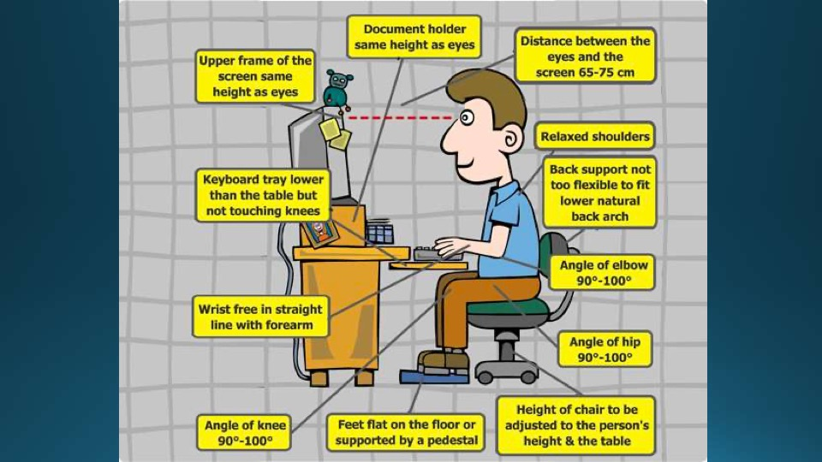
Ergonomics
65cm = 25.6 in
75cm = 29.5 in
Notes:
Image from Eric Silva, Hawk Mountain Council, STEM Day 2016

Slide 15

Electrical safety
Keep liquid and food away from plugged-in machines
Be sure the equipment is properly grounded to prevent shock hazards
It’s best to unplug the computer when it’s not in use, especially during a thunderstorm
Make sure any cords are neatly stowed to prevent tripping

Slide 16
Additional pointers
Computer-Related Repetitive Stress Injuries (Johns Hopkins): https://www.hopkinsallchildrens.org/Patients-Families/Health-Library/HealthDocNew/Computer-Related-Repetitive-Stress-Injuries
12 tips for an Ergonomic Computer Workstation (Cornell University): http://ergo.human.cornell.edu/DEA6510/dea6512k/ergo12tips.html
25 Ergonomic Tips For Students When Working At A Computer (Vista College): https://www.vistacollege.edu/blog/resources/25-ergonomic-tips-when-working-at-a-computer/

Slide 17
History of programming
Do the following:
a. Discuss with your counselor the history of programming and programming languages, and discuss how programming languages have evolved over time to become easier to use while adding additional capabilities.
b. Discuss with your counselor the history of programming and the evolution of programming languages.

Slide 18
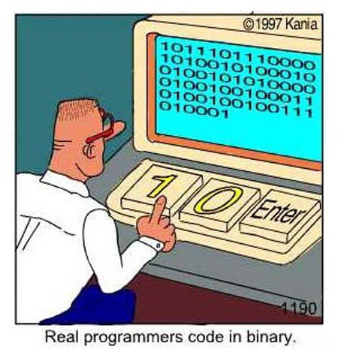

Slide 19
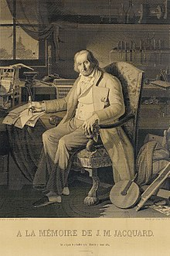
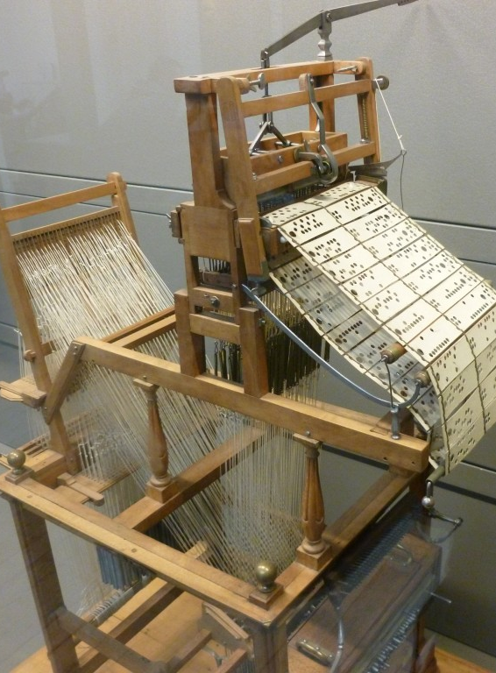
Before Computers
Before the modern electrical computer, mechanical devices used in factories were the first machines to be programmed.
An example is the Joseph Jacquard Loom (1804) which used hole-punched cards to “program” patterns into fabric.
The picture on the left is the loom.
The picture on the right is a portrait of Jacquard was woven in silk on a Jacquard loom and required 24,000 punched cards to create (1839). One of these portraits in the possession of Charles Babbage inspired him in using perforated cards in his Difference Engine.

Slide 20
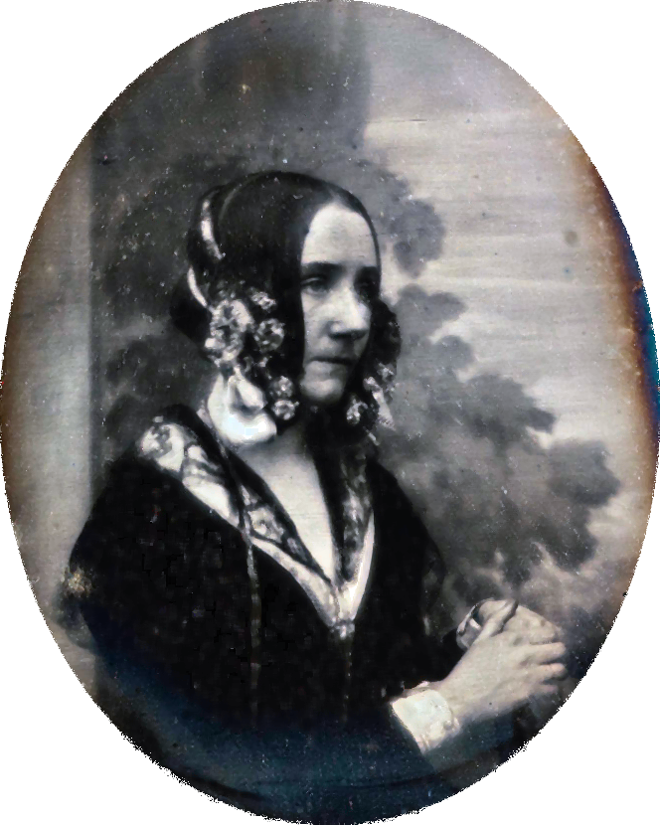
Ada Lovelace
(1815 – 1852)
Notes:
https://en.wikipedia.org/wiki/Ada_Lovelace

Slide 21
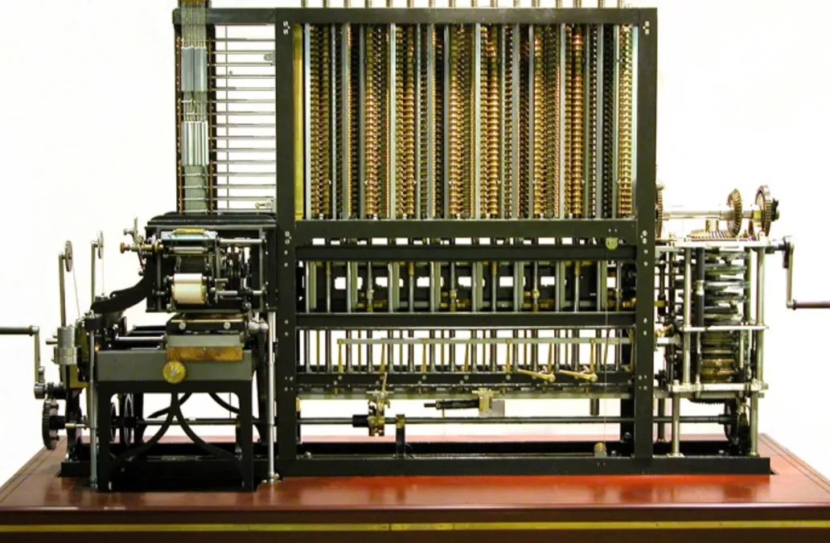
Before Computers
Charles Babbage in 1823 started work on his Difference Engine. It was programmed using punch cards and could do simple calculations to 31 digits. Due to high costs, it was not built until 1991, well after his death. It weighed 15 tons and was 8 ft tall.
It used human-power to turn the gears and cranks and output the result using wheels with digits painted on.
Fun Fact: The gear technology didn’t exist to build his machine, so Babbage invented new ways of cutting gears. This incidentally advanced machinery and factories during the end industrial revolution (1760-1840).
Ada Lovelace, the first programmer, theorized how to program Babbage's Machines.

Slide 22
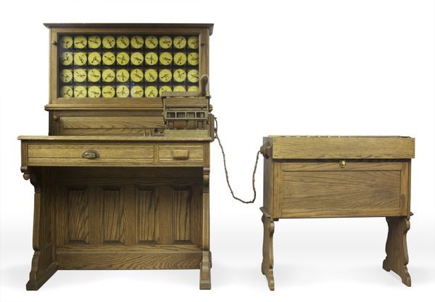
Before Computers
In 1885, Herman Hollerith designed the “Electric Tabulating System”, a machine designed to take on the 1890’s Census. It was an early Scantron-like machine using punch cards.
The 1880’s Census took 7 years to count, so due to the growing population, the 1890’s and 1900’s Censuses would have taken more than 10 years. This would not be good.
With his machine, the 1890’s Census only took 6 weeks rather than 10 years. This proved computers were a viable solution to many previously impossible problems.

Slide 23
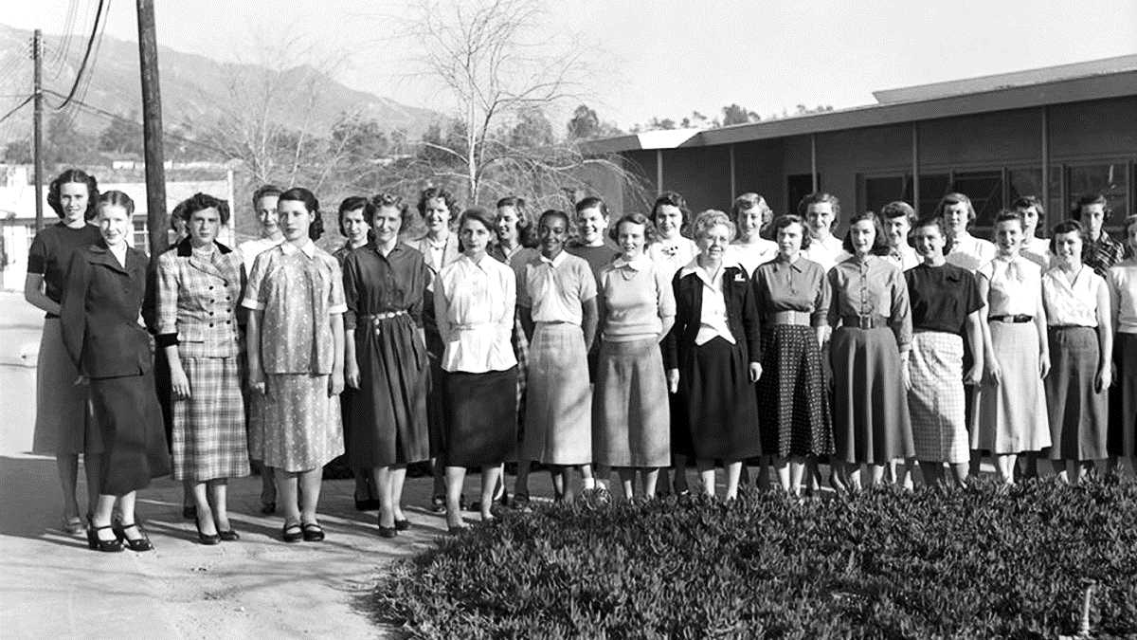
First Computers
What did the first computers look like?

Slide 24
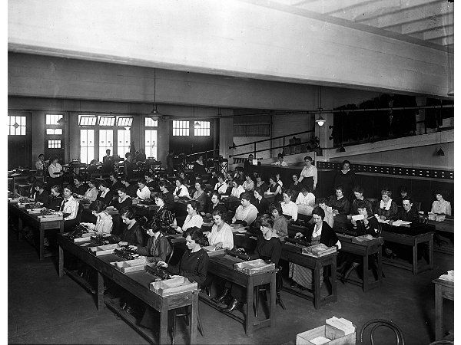
First Computers
A “Computer” used to be a job description, not an electronic machine
Women almost exclusively filled these positions.
Large agencies would have “Computer Rooms” with many ladies doing calculations by hand
A “kilogirl” was a unit of measurement equaling 1000 hours of computing labor

Slide 25
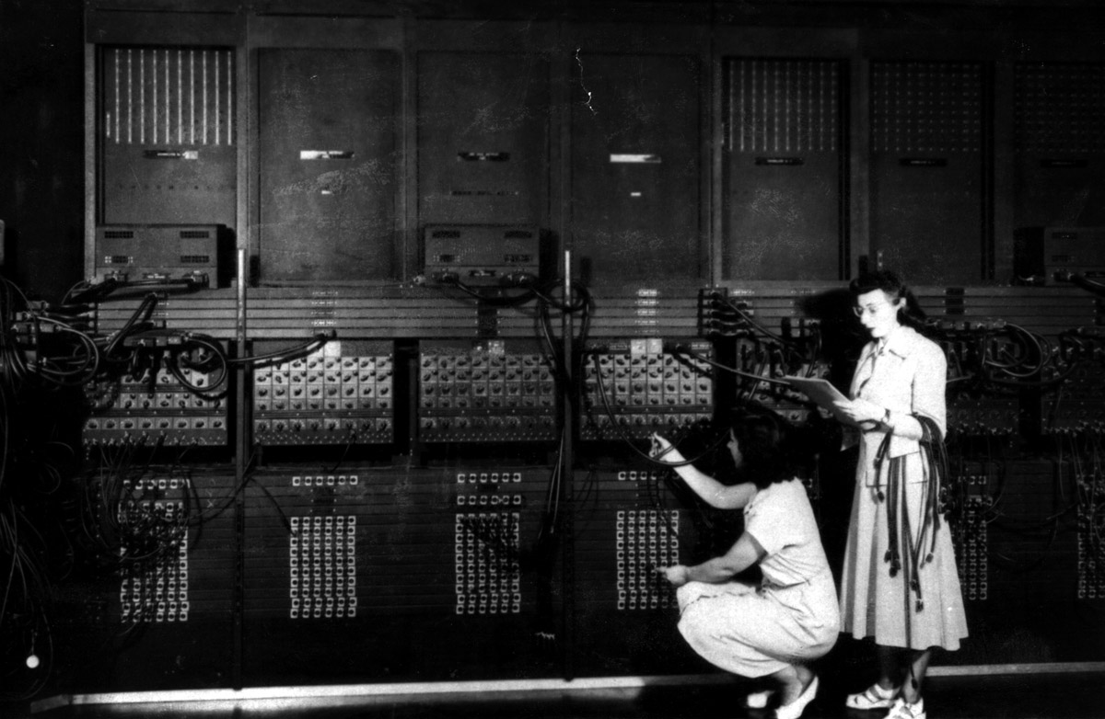
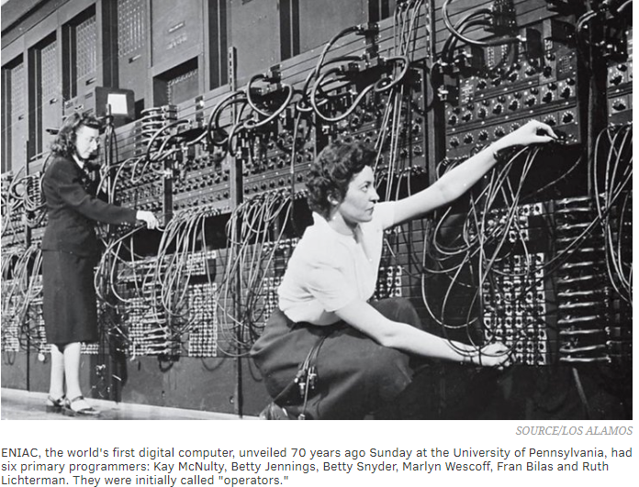
Early Computers
ENIAC – Electronic Numerical Integrator And Computer (1946)
First general-purpose computer
Used Base-10 instead of Binary (Base-2)
They used Vacuum Tubes and Mechanical Switches
Used to calculate firing-tables for the military.
UNIVAC – UNIVersal Automatic Computer (1951)
First commercial computer
Brought computers into the public eye after it correctly predicted the “total-upset, landslide”, 1952 Presidential Election.
ENIAC 1946 – What do you notice about this photo
Notes:
Women, not men, were the ones running these early computers.
This led to many women leading computer science into the 21st century, i.e. Grace Hopper, who programed the ENIAC. She also designed COBOL. This language is still used today.

Slide 26
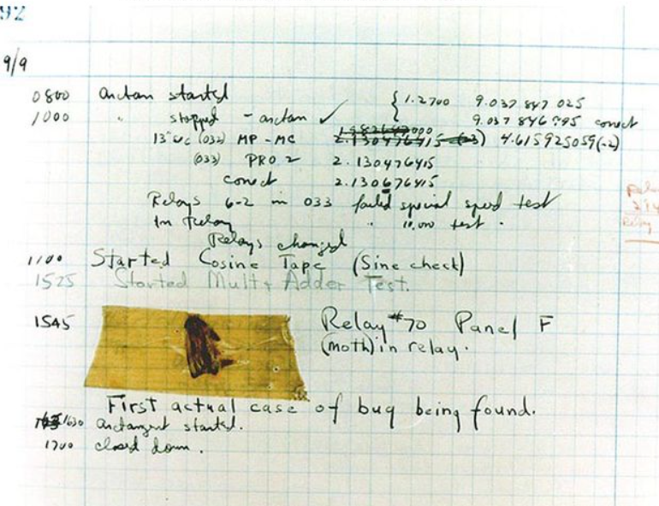
First computer bug (it's literal)

Slide 27
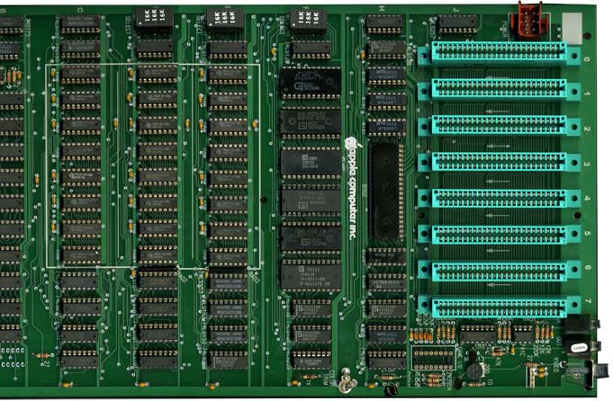
Pre-Modern Computers
After Vacuum Tube and Mechanical Switched computers, Integrated Circuits (ICs) allowed computers to get much smaller. Computers when from the Size of buildings to the size of desks.
This also allowed more powerful computers to be built because less space was needed.
This is an Apple2 motherboard.
All the black chips make the CPU.
Each one is about 1” wide.

Slide 28
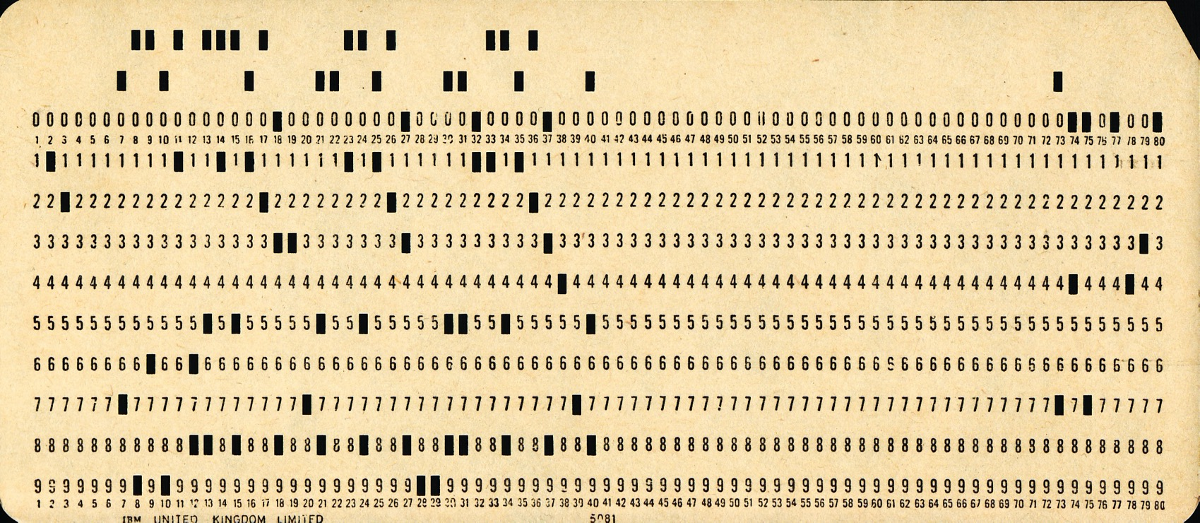
A punch card

Slide 29
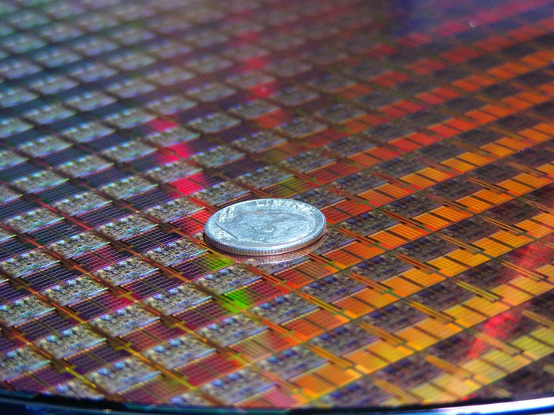
Modern Computers
The Microprocessor allowed computers to go from the size of desks to the size of a dime!
Each small square in this picture is a computer!
This allowed us to make computers even more powerful and allow us to use even more powerful language features.
Each “switch” in these chips are 10nm wide

Slide 30
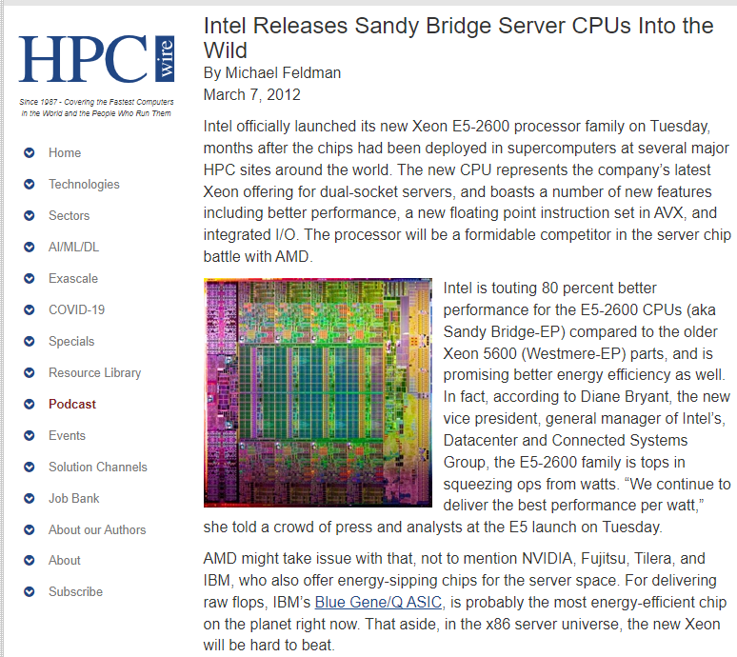
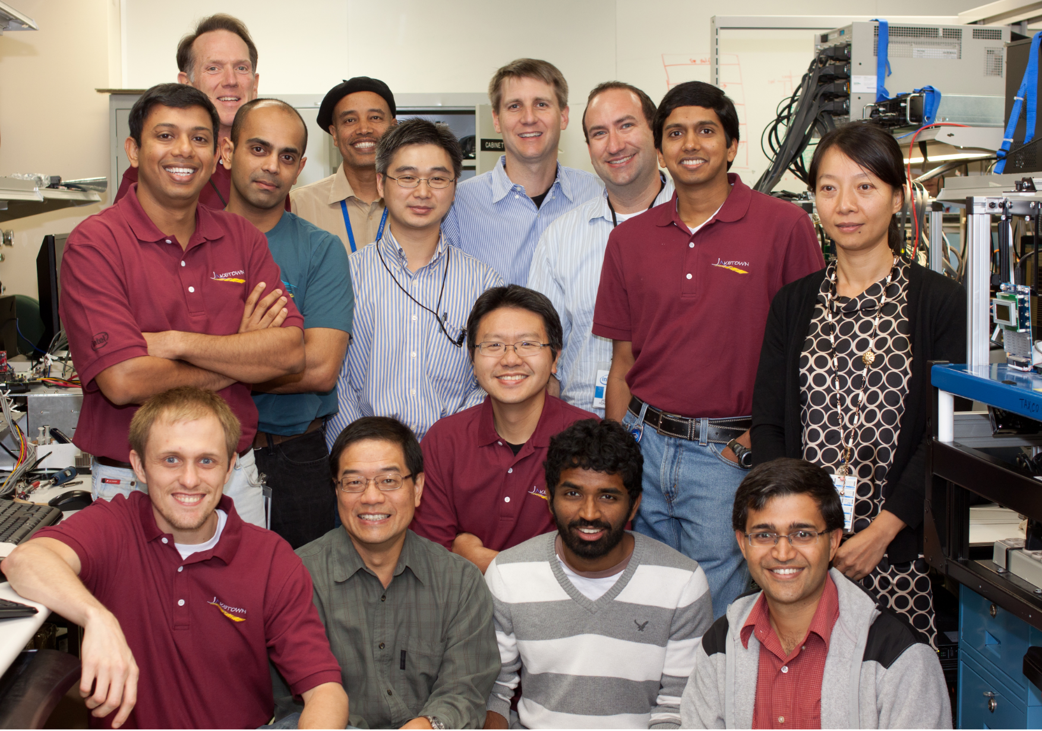
Architecting CPUs are fun! Is there anyone you know?
Sandy Bridge EP (Jaketown) Power Performance Team

Slide 31
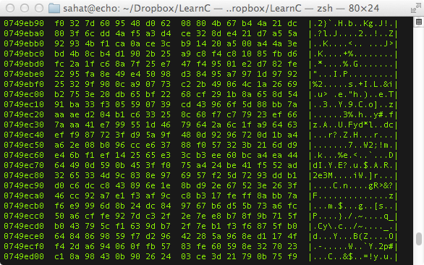
History of Programming
What was the first programming language?
Binary / Machine Language (ML)
Binary / ML is really hard to read, but it can be done.
Early computers used switches and cables to accomplish this.
It is insanely fast, only limited by hardware speed.
All programming languages end up as Binary / ML at some point during execution.
Notes:
Notice that is Binary / ML is actually represented in Hex, which is just a more compact way for writing Binary.
The column of 8 numbers on the left is the hardware memory address in RAM where each line of code is stored.
The next two big columns are the actual code separated into bytes (each 2 characters is 1 byte).
The third column is the ASCII representation of the data in the previous two big columns.

Slide 32
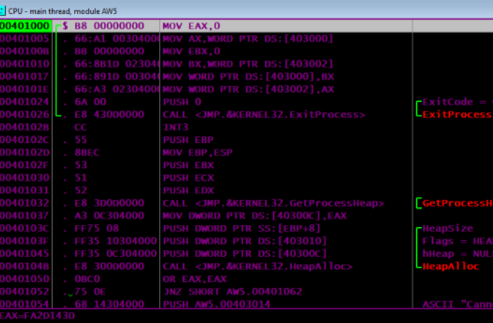
History of Programming
Next came Assembly Language (ASM)
Slightly easier to read than Binary / ML
Still very fast because it maps back to Binary / ML
Very few people ‘need’ to program is ASM
There is a different Assembly Language for each CPU design, so it is not portable code.
Why is portable code good?
Notes:
This is a program I wrote for my Assembly class.
In this photo you can see the hardware memory address in the left-most column.
In the widest column is a x86-Assembly code (MOV EAX,0)
The second column from the left is the Machine Language generated from the x86-Assembly code.

Slide 33
History of Programming
Next-Generation Languages came around the 1950’s.
They allowed:
Code portability between different systems
Easier to write, read and debug code
Allowed for new concepts (i.e. functions, classes, objects, OOP)
Explored new fields (i.e. science, math, computer science, data science, business)
The first big languages were… (in order of creation)
FORTRAN, LISP, COBOL, BASIC and Pascal
Notes:
A lot of old code that was written in FORTRAN or COBOL is still in use today because it would be too expensive to rewrite it.
Also there are huge sections of code that is “dead-code”. People don’t know what it does, so they don’t touch it and it just sits there.

Slide 34
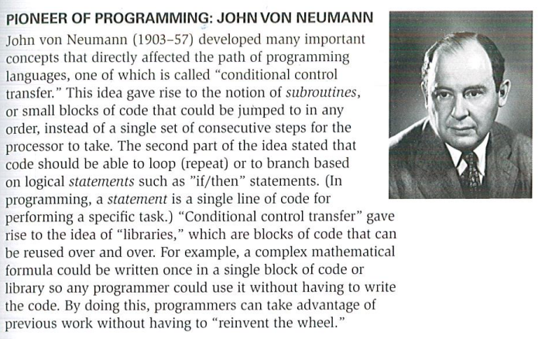

Slide 35
Program to Execution
#include <stdio.h>
void swap(int* xp, int* yp)
{
int temp = *xp;
*xp = *yp;
*yp = temp;
}
void bubbleSort(int arr[], int n)
{
int i, j;
for (i = 0; i < n - 1; i++)
// Last i elements are already in place
for (j = 0; j < n - i - 1; j++)
if (arr[j] > arr[j + 1])
swap(&arr[j], &arr[j + 1]);
}
// Driver program to test above functions
int main()
{
int arr[] = { 64, 34, 25, 12, 22, 11, 90 };
int n = sizeof(arr) / sizeof(arr[0]);
bubbleSort(arr, n);
return 0;
}

Slide 36
Notes:
Image from Eric Silva, Hawk Mountain Council, STEM Day 2016

Slide 37
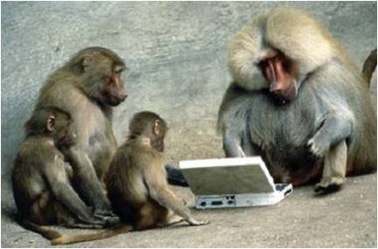
Not everyone is good at this

Slide 38
History of programming
Next-Generation Languages came around the 1950’s.
They allowed:
Code portability between different systems
Easier to write, read and debug code
Allowed for new concepts (i.e. functions, classes, objects, OOP)
Explored new fields (i.e. science, math, computer science, data science, business)
The first big languages were… (in order of creation)
FORTRAN, LISP, COBOL, BASIC and Pascal
Notes:
Adapted from Robert Baker, 2018
A lot of old code that was written in FORTRAN or COBOL is still in use today because it would be too expensive to rewrite it.
Also there are huge sections of code that is “dead-code”. People don’t know what it does, so they don’t touch it and it just sits there.

Slide 39
Additional pointers
History of programming languages: https://en.wikipedia.org/wiki/History_of_programming_languages
Visual history of programming languages: https://visual.ly/community/infographic/technology/history-computer-programming
Ada Lovelace: https://en.wikipedia.org/wiki/Ada_Lovelace

Slide 40
3. General knowledge
Do the following:
a. Create a list of 10 popular programming languages in use today and describe which industry or industries they are primarily used in and why.
b. Describe three different programmed devices you rely on every day.

Slide 41
Programming Now
How many languages do you recognize?
C
C++
Java
JavaScript
HTML
CSS
Python
Ruby
PHP
OpenCL
SQL
MATLAB
Erlang
Ada
Objective-C
Swift
Mathematica
C#
Visual Basic
Rust
F#
R
Go
PowerShell
BASH
TypeScript
PostScript
CoffeeScript
Perl
x86-Assembly MASM
RegEx
PL/SQL
MIPS
ColdFusion
LaTeX
XML
JSON
Ladder Logic
YAML
Batch
Notes:
Adapted from Robert Baker, 2018

Slide 42
Programming Now
Why are the languages grouped into colors?
C
C++
Java
JavaScript
HTML
CSS
Python
Ruby
PHP
OpenCL
SQL
MATLAB
Erlang
Ada
Objective-C
Swift
Mathematica
C#
Visual Basic
Rust
F#
R
Go
PowerShell
BASH
TypeScript
PostScript
CoffeeScript
Perl
x86-Assembly MASM
RegEx
PL/SQL
MIPS
ColdFusion
LaTeX
XML
JSON
Ladder Logic
YAML
Batch
Notes:
Adapted from Robert Baker, 2018

Slide 43
C
C++
Java
JavaScript
HTML
CSS
Python
Ruby
PHP
OpenCL
SQL
MATLAB
Erlang
Ada
Objective-C
Swift
Mathematica
C#
Visual Basic
Rust
F#
R
Go
PowerShell
BASH
TypeScript
PostScript
CoffeeScript
Perl
x86-Assembly MASM
RegEx
PL/SQL
MIPS
ColdFusion
LaTeX
XML
JSON
Ladder Logic
YAML
Batch
The Green Languages are General Programing Languages
The Purple Languages are Scripting Languages
The Red Languages are Markup Languages
The Blue Languages are Declarative Languages
The Orange Languages are Assembly Languages
Different types of languages have different purposes.
It is important to match the type of work to the correct language to insure the best results.
Notes:
Adapted from Robert Baker, 2018

Slide 44
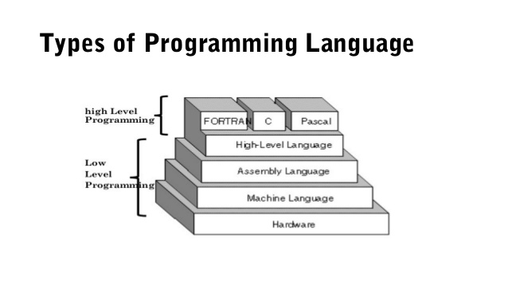
Programming Language Types
Why would you use a High-Level, Low-Level or C-Level language?
Low Level
Pros: Fast Execution, No Overhead, Single Platform, Compiled
Cons: Hard to read, write, debug, and maintain
Examples: ML, MASM, TASM, NASM, MIPS
High-Level
Pros: Easier to read, write, debug, and maintain, Multi-Platform, Compiled or Interpreted
Cons: Slower than Low-Level, not as much control over hardware
Examples: Python, Ladder-Logic, JavaScript, Java, SQL
C-Level
Best of both worlds, Compiled
Good control over hardware with ease of writing.
Examples: C, C++, Rust, FORTRAN, PASCAL
Notice: Java, Python, etc. are one level higher than FORTAN, C and PASCAL
Notes:
Adapted from Robert Baker, 2018

Slide 45
Programming Languages
Here are a few languages and the problems they try to tackle…
C++ – General Purpose, High Performance | ex. Game Engines, Desktop Apps (Adobe Photoshop, Chrome)
C – General Purpose, High Performance, Light Weight | ex. Linux OS, macOS, Integrated Circuits, Drivers
Java – General Purpose, Multiplatform | ex. Minecraft, Server Apps, Android Apps
C# – General Purpose, Windows Platform | ex. Unity Games, Server Apps, StackOverflow
Swift – General Purpose, iOS & macOS | ex. most apps for iPhones and macOS (replaced Objective-C)
SQL – Database Communication
JavaScript – General Web Scripting | ex. Interactive webpages, webpages that can run dynamic code
HTML – Webpage Design, Layout and Markup
CSS – Webpage Styling, Coloring, Fonts and Positioning
PHP – Web Server Code | ex. Backend Web Dev., Web Content Management Systems (i.e. WordPress)
TypeScript – Stricter Superset of JS that transpiles into JS |ex. Large JavaScript Apps
XML – Human and Machine readable file format for data sharing between apps
Notes:
Adapted from Robert Baker, 2018

Slide 46
Notes:
Blue insert by Nate Swedberg

Slide 47
Programming Examples
Hello World
JavaScript
myString = "Hello World!";
console.log(myString);
Python
myString = 'Hello World!'
print(myString)
Notice how different languages can look very different even when they are doing the same task.
Notes:
Adapted from Robert Baker, 2018
The reason for the different colors here is due to syntax highlighting.
Syntax Highlighting is a feature in programming apps where it automatically colors different parts of the code to increase readability.

Slide 48
Programming Examples
Hello World
C++
#include <iostream> int main(int argc, char *argv[])
{
char myString[] = “Hello World!”;
std::cout << myString << std::endl;
return 0;
}
Java
class HelloWorld {
private String myString = "Hello World!";
public static void main(String args[]) {
System.out.println(myString);
}
}
Notice how different languages can look very different even when they are doing the same task.
Notice also how the bracing ( i.e. “{}”) style is different between languages.
Notes:
Adapted from Robert Baker, 2018
The reason for the different colors here is due to syntax highlighting.
Syntax Highlighting is a feature in programming apps where it automatically colors different parts of the code to increase readability.

Slide 49
Programming Examples
Hello World C#
using System;
using System.Collections.Generic;
using System.Text;
namespace ConsoleApplication1
{
class HelloWorld
{
String myString = "Hello, world!";
static void Main(string[] args)
{
Console.WriteLine(myString);
}
}
}
X86 Assembly
.486
.model flat, stdcall
.stack 100h
option casemap :none
ExitProcess PROTO Near32 stdcall, dwExitCode:dword
putch PROTO Near32 stdcall, bChar:byte; .data
strMyString byte "Hello World",0
.code
main PROC
mov ecx, LENGTHOF strMyString
mov esi, OFFSET strMyString
L1:
invoke putch, byte PTR esi
inc esi
loop L1
invoke ExitProcess,0
main ENDP
END main
Notes:
Adapted from Robert Baker, 2018
The reason for the different colors here is due to syntax highlighting.
Syntax Highlighting is a feature in programming apps where it automatically colors different parts of the code to increase readability.

Slide 50
Notes:
Blue insert by Nate Swedberg

Slide 51
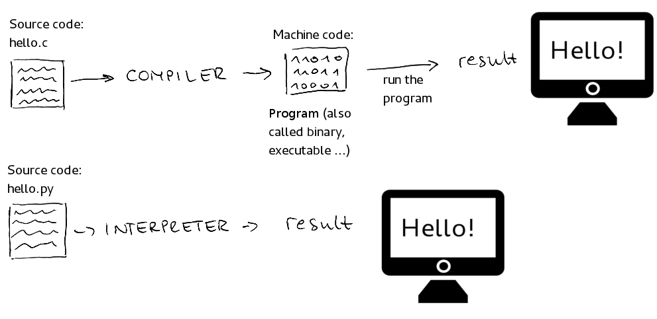
Programming Language Types
This photo illiterates the difference between compiled and interpreted languages…
Use your computers to make a list of 3 compiled languages and 3 interpreted languages.
Where would you use a compiled languages vs an interpreted language?
Done every time
Done once
Done every time
Notes:
Adapted from Robert Baker, 2018

Slide 52
Notes:
Blue insert by Nate Swedberg

Slide 53
Programmed Devices
Our lives are filled with so many programmed devices, you many not even notice…
What are somethings around your house that are programmed?
Smart TVs, Smart Door Bells
Xbox, PlayStation, Wii, Ms. Pacman
Microwave, Wi-Fi Router (these two are the same thing)
Etc..
What language do you think these were programmed in?
Notes:
Adapted from Robert Baker, 2018

Slide 54
Additional pointers
100 Of The Most Popular Programming Languages Explained In Minutes: https://www.whoishostingthis.com/resources/programming/
Code academy: www.codeacademy.com
Code.org: www.code.org
Learn Python: www.learnpython.org
Learn C++: www.learncpp.com
Scratch: scratch.mit.edu
Killer PHP: www.killerphp.com
W3 Schools: www.w3schools.com

Slide 55
4. Intellectual property:
Do the following:
a. Explain the four types of intellectual property used to protect computer programs.
b. Describe the difference between licensing and owning software
c. Describe the differences between freeware, open source, and commercial software, and why it is important to respect the terms of use of each.

Slide 56
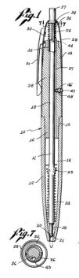
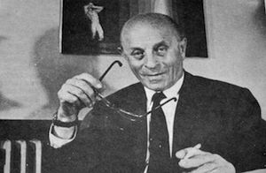
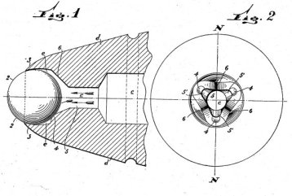
László Jozsef Bíró,
the inventor of the ballpoint pen
U.S. Patent No. 2390636:
“Writing Instrument.”
U.S. Patent No. 2734484:
“Ball Point Pen.”
Notes:
BIC is a physical item – it’s a ballpoint, invented by …
Interesting idea: before writing with a “ballpoint pen”, we were writing with a “fountain pen”
Full story: https://www.ipwatchdog.com/2014/12/10/the-evolution-of-modern-ballpoint-pen-a-patent-history/id=52550/

Slide 57
Intellectual Property
Notes:
IP = creation that cannot be touched or held, such as ideas, plans and designs.

Slide 58
Copyright protection (©)
Protects a particular expression of an idea that the author created
Automatic + registration with the U.S. Copyright Office (~ $85)
Intellectual Property

Slide 59
Copyright protection (©)
Protects expression of idea
The Merit Badge Book is © BSA
Powerpoints, game art, specific code, …
Intellectual Property

Slide 60
Copyright protection (©)
Protects a particular expression of an idea that the author created
Automatic + registration with the U.S. Copyright Office (~ $85)
Intellectual Property
Patents
Protects useful innovative processes or methods, machines, manufactured items, or “compositions of matter”.
Must be applied for (USPTO)
Need to describe inner workings

Slide 61
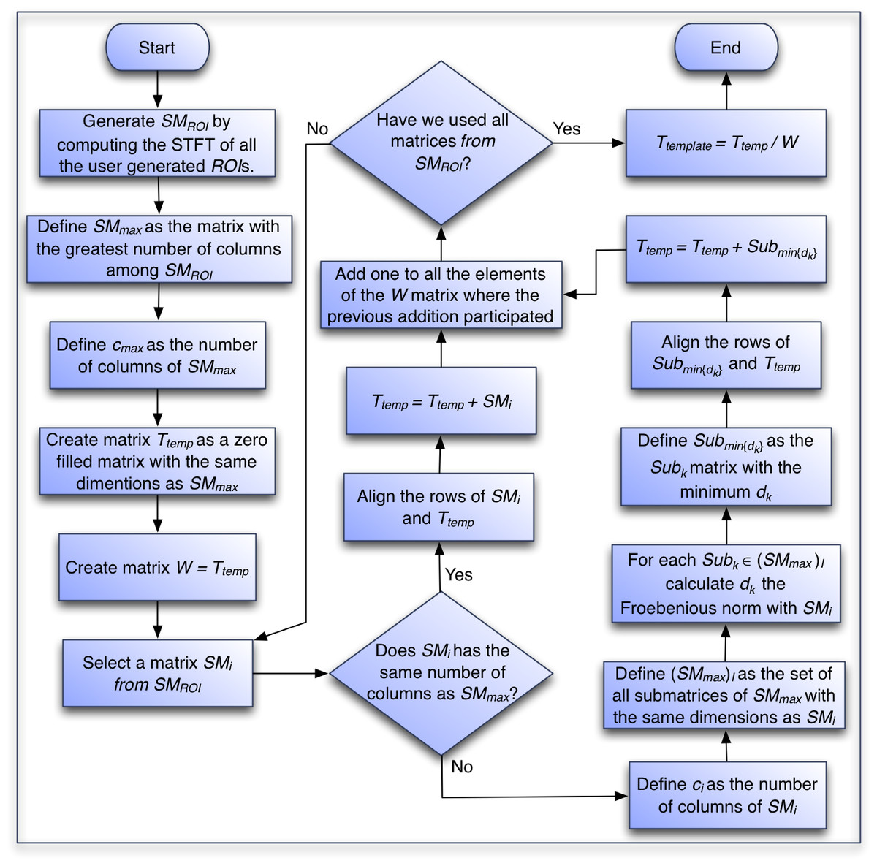
Copyright protection (©)
Protects a particular expression of an idea that the author created
Automatic + registration with the U.S. Copyright Office (~ $85)
Intellectual Property
Patents
Protects useful and innovative processes or methods, machines, manufactured items, …
A new and revolutionary math algorithm used in an app
This Photo by Unknown Author is licensed under CC BY

Slide 62
Trademark (™)
Copyright protection (©)
Protects a word, phrase, symbol, sound or color that identifies or distinguishes the source of a particular product or service
Protects a particular expression of an idea that the author created
Automatic + registration with the U.S. Copyright Office (~ $85)
Intellectual Property
Patents
Protects useful innovative processes or methods, machines, manufactured items, or “compositions of matter”.
Must be applied for (USPTO)
Need to describe inner workings
This Photo by Unknown Author is licensed under CC BY

Slide 63


Trademark (™)
Copyright protection (©)
Protects a word, phrase, symbol, sound or color that identifies or distinguishes the source of a particular product or service
Protects a particular expression of an idea that the author created
Automatic + registration with the U.S. Copyright Office (~ $85)
Intellectual Property
Patents
Protects useful innovative processes or methods, machines, manufactured items, or “compositions of matter”.
Must be applied for (USPTO)
Need to describe inner workings
This Photo by Unknown Author is licensed under CC BY
Notes:
Girl Scouts vs. Boys Scouts: https://www.ipwatchdog.com/2018/12/27/girl-scouts-file-trademark-complaint-against-rival-boy-scouts/id=104458/
The crux of the Girl Scouts’ claims is that their organization owns the exclusive right to use the trademark SCOUT (and variations) for enrichment programing for girls, and that the Boy Scouts’ use of the terms in connection with enrichment programming for girls violates the Girl Scouts organization’s trademark rights.
Flappy Bird: https://www.kaufholdpatentgroup.com/the-legal-issues-standing-in-the-way-of-a-flappy-bird-return/

Slide 64
Trademark (™)
Copyright protection (©)
Protects a word, phrase, symbol, soud or color that identifies or distinguishes the source of a particular product or service
Protects a particular expression of an idea that the author created
Automatic + registration with the U.S. Copyright Office (~ $85)
Intellectual Property
Patents
Trade secrets
Protects useful innovative processes or methods, machines, manufactured items, or “compositions of matter”.
Must be applied for (USPTO)
Need to describe inner workings
Protects valuable information by not disclosing it to anyone, enforced by a contract called a NDA (Non Disclosure Agreement)
This Photo by Unknown Author is licensed under CC BY

Slide 65
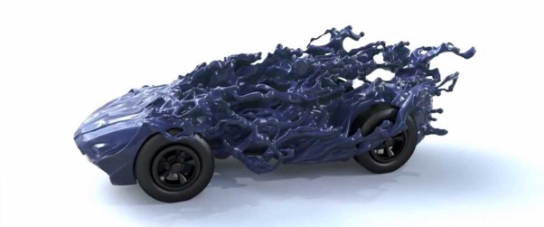
Trademark (™)
Copyright protection (©)
Protects a word, phrase, symbol, soud or color that identifies or distinguishes the source of a particular product or service
Protects a particular expression of an idea that the author created
Automatic + registration with the U.S. Copyright Office (~ $85)
Intellectual Property
Patents
Trade secrets
Protects useful innovative processes or methods, machines, manufactured items, or “compositions of matter”.
Must be applied for (USPTO)
Need to describe inner workings
Protects valuable information by not disclosing it to anyone, enforced by a contract called a NDA
What info Facebook collects, PWD cars, …
This Photo by Unknown Author is licensed under CC BY

Slide 66

Selling your software
Freeware - 100% free to use, not necessarily free to be modified or distributed
Shareware - free to download and use but asked for donations (i.e. Ad-Block). Not free to modify or distribute
Demo - A free trial version of the program, may not have all the features enabled. Not free to modify or distribute
Closed Source - the code is NOT exposed to the public and cannot be edited or distributed (doesn’t mean free)
Open Source - the code is exposed to the public and can be modified or distributed, may be limits or restrictions (doesn’t mean free)
Public Domain – There is absolutely no ownership such as copyright, trademark, or patent. Software in the public domain can be modified, distributed, or sold even without any attribution by anyone

Slide 67


Software piracy
Notes:
FBI Anti-Piracy Warning Seal: https://www.fbi.gov/investigate/white-collar-crime/piracy-ip-theft/fbi-anti-piracy-warning-seal
Blue insert by Nate Swedberg

Slide 68
Owning or licensing?
Do I own a copy of PowerPoint?
Do I own a copy of Google Chrome?
Do I own a copy of an App I built?
What is the difference between owning and licensing?
Owning means you have every right to do what you want with the software or code. Most people do not own software.
Licensing is where you “buy or get permission” to use the software, often subscription based.

Slide 69
Additional pointers
What is Open Source? https://opensource.com/resources/what-open-source
The Open Source Initiative: https://opensource.org/
Intellectual Property: https://en.wikipedia.org/wiki/Intellectual_property
Intellectual Property Theft/Piracy: https://www.fbi.gov/investigate/white-collar-crime/piracy-ip-theft

Slide 70
5. Projects. Do the following: a. With your counselor’s approval, choose a sample program. Modify the code or add a function or subroutine to it. Debug and demonstrate the modified program to your counselor. b. With your counselor’s approval, choose a second programming language and development environment, different from those used for requirement 5a and in a different industry from 5a. Then write, debug, and demonstrate a functioning program to your counselor, using that language and environment. c. With your counselor’s approval, choose a third programming language and development environment, different from those used for requirements 5a and 5b and in a different industry from 5a or 5b. Then write, debug, and demonstrate a functioning program to your counselor, using that language and environment. d. Explain how the programs you wrote for requirements 5a, 5b, and 5c process inputs, how they make decisions based on those inputs, and how they provide outputs based on the decision making.

Slide 71
6. Careers
Find out about three career opportunities that require knowledge in programming. Pick one and find out the education, training, and experience required. Discuss this with your counselor and explain why this career might be of interest to you

Slide 72
Where is programming used?
Mobile devices
Business applications
Factory automation
Robotics
Internet
Animation
Entertainment
Outdoor
Engineering
Science
Automobiles
Traffic control
Information security
Gadgets
Medical devices
Healthcare
…
Can you find examples around you?

Slide 73
Careers in Programming
What are some careers you have heard of in a programming field?
Computer Scientist
Mobile App Developer (dev)
Desktop App Dev
UI / UX Engineer
Software Engineer
Game Engine Dev
Gameplay Dev
Database Engineer
Hardware Engineer
Computer Engineer
Sysadmin
Validation Engineer
Web Dev (frontend and backend)

Slide 74
Additional pointers
Examples of programs for different industries (Boys Life): https://boyslife.org/merit-badges/programming-merit-badge/
How to become a computer programmer? (Learn How To Become): https://www.learnhowtobecome.org/computer-programmer/
9 Programming Careers for Coding Connoisseurs (Rasmussen College): https://www.rasmussen.edu/degrees/technology/blog/programming-careers-for-coding-connoisseurs/
What Does a Computer Programmer Do? (The Balance Career): https://www.thebalancecareers.com/what-does-a-computer-programmer-do-525996
10 signs a career in coding and software development might be right for you (The Guardian): https://www.theguardian.com/careers/ten-signs-career-coding-software-development-right-for-you

Slide 75
PRogramming
OnlineGDB is a general programming environment which supports multiple languages
https://www.onlinegdb.com/
C
Is a language used for system level programming
C++
An extension of C that provides object oriented programming
Prolog
Prolog is a totally different language created for logic and expert systems
p5*js
https://p5js.org/examples/

Slide 76
Requirements
5. Projects. Do the following:
a. With your counselor’s approval, choose a sample program. Modify the code or add a function or subroutine to it. Debug and demonstrate the modified program to your counselor.

Slide 77
Let the ball bounce
Programming Language – Python
Basic concepts – variables, functions, condition, loops
Simple graphics library – turtle
Online compiler – https://trinket.io/turtle
Reference code – https://thepythoncodingbook.com/2021/08/19/simulating-a-bouncing-ball-in-python/

Slide 78
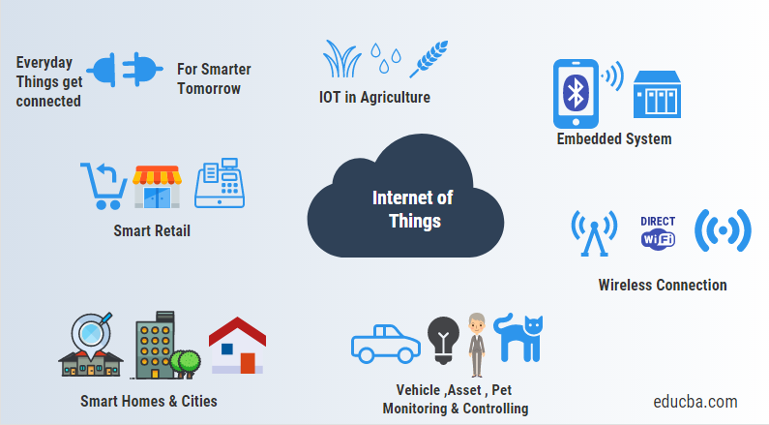
Internet of things

Slide 79
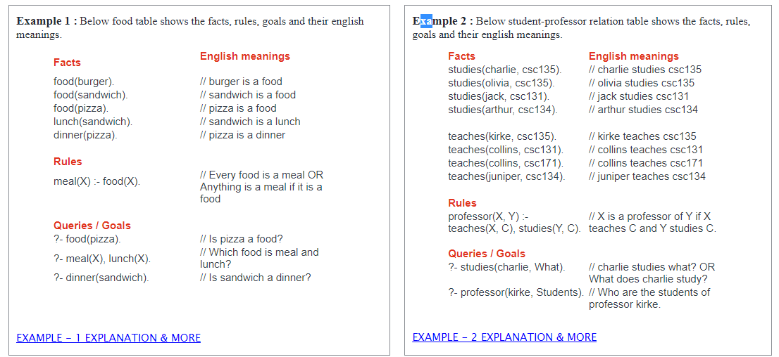
Prolog

Slide 80

Simulation for finding PI using JAVA
Mr. Rowland
This Photo by Unknown Author is licensed under CC BY-SA

Slide 81
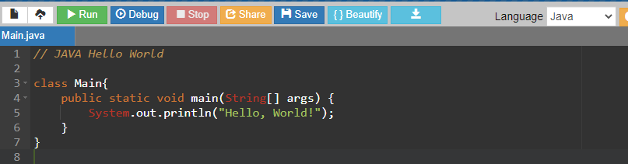
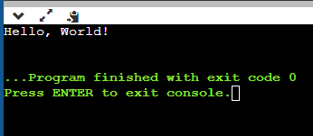
Let’s learn some basic JAVA
Python uses indentation as part of its syntax (unlike C or C++)
Its not just for looking pretty
Use Tab to indent.
Variables types do not have to be declared
We will be using https://www.onlinegdb.com/
Select JAVA
Let’s print “hello world”
Type in the code to the right
Class - the building block that leads to Object-Oriented programming
Public – access specifier
Static - member belongs to a type itself, rather than to an instance of that type
Void - method does not return any type
Main - entry point for executing
System – an object
Hit the green “Run” button
// JAVA Hello World
class Main{
public static void main(String[] args) {
System.out.println("Hello, World!");
}
}

Slide 82
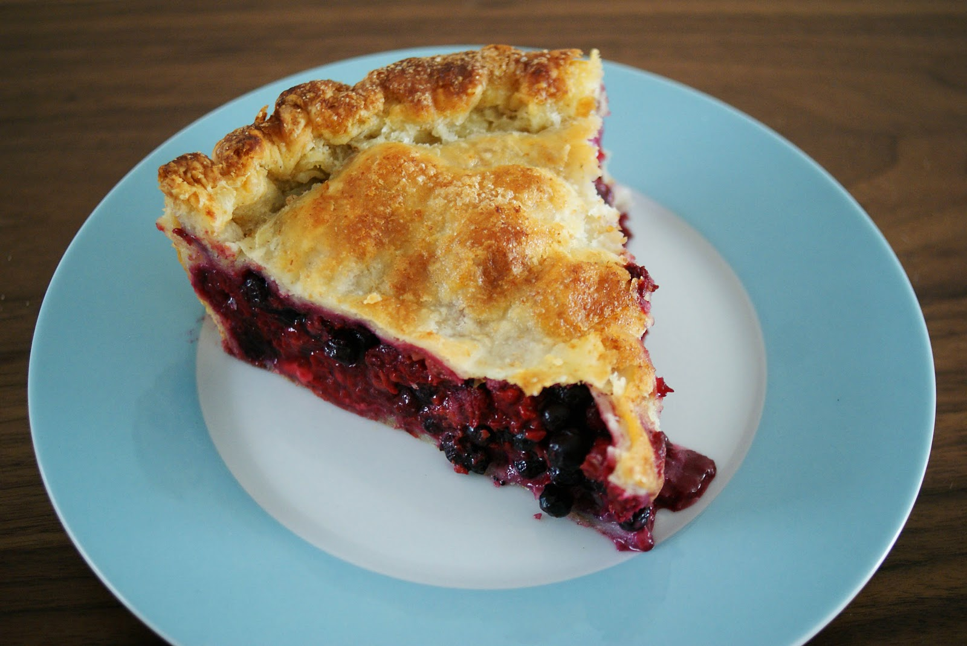

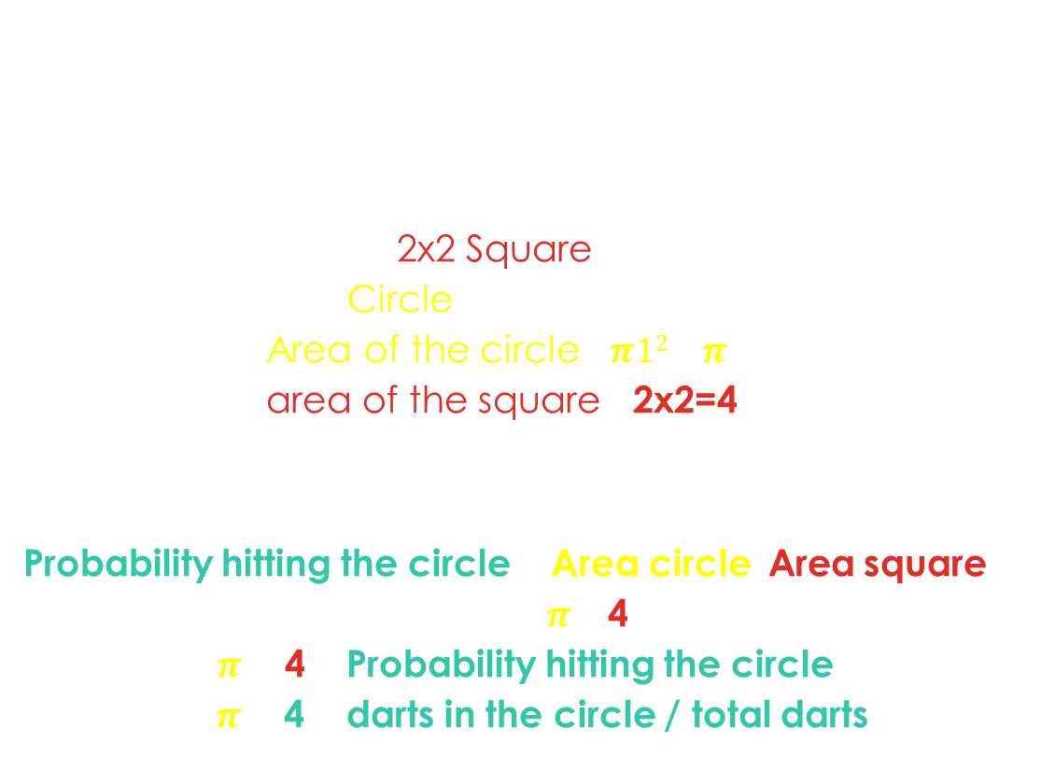
can we compute $π$? Or just eat it?
What formulas have $π$in them?
Area of a circle: $πr2$
Circumference of a circle: 2$πr$
Let’s compute $π$ by throwing Darts? What?!?!?
What if we have a 2x2 Square
And we have a Circle of radius one inside it
What is the Area of the circle? $π12$= $π$
What is the area of the square? 2x2=4
What is the probability of a random dart landing in the circle?
Probability hitting the circle = Area circle/Area square
= $π$ / 4
Solving for $π$ = 4 x Probability hitting the circle
$π$ = 4 x darts in the circle / total darts
2
1
1
2
X-axis
-1
0
1
Y-axis
-1

Slide 83
Let’s Theoretically throw a dart
Double - a data type that can store fractional numbers from 1.7e−308 to 1.7e+308.
Create variables for where the dart lands: x and y
Math.random generates random numbers between 0 – 0.99999
Create an equation for generating numbers between -1 to 1
Print out where the dart landed
public class Main{
public static void main (String[]args){
double x, y;
x = (2 * Math.random ()) - 1;
y = (2 * Math.random ()) - 1;
System.out.printf ("dart at X %f Y %f\n", x, y);
}
}

Slide 84
LeT’s throw a thousand darts
Loops in Java come into use when we need to repeatedly execute a block of statements.
Syntax: for( initial val; exit condition; next value){ statement; }
Example: for(double i=1.0; i<101; i++){ System.out.print(“%f “,i); }
Use a for loop to generate a 1000 darts
public class Main{
public static void main (String[]args){
double x, y;
int maxThrows = 1000, dartThrow;
for (dartThrow = 0; dartThrow < maxThrows; dartThrow++){
x = (2 * Math.random ()) - 1;
y = (2 * Math.random ()) - 1;
System.out.printf (“dart at X %f Y %f\n", x, y);
}
}
}

Slide 85
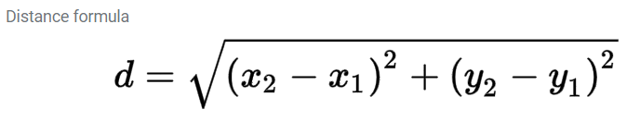
How Many Land inside the Circle
Record how many darts land inside the circle
They are inside the circle if the distance to point 0,0 is less or equal to one
The distance formula is:
In JAVA assuming distance to the origin (0,0)
D = Math.sqrt(Math.pow(x,2)+Math.pow (y, 2))
Use an if statement to test and keep count of the darts landing inside the circle
Syntax:
if (Boolean condition) {
Code executed if condition is true
}
public class Main{
public static void main (String[]args){
double x, y;
int hits = 0;
int maxThrows = 1000, dartThrow;
for (dartThrow = 0; dartThrow < maxThrows; dartThrow++){
x = (2 * Math.random ()) - 1;
y = (2 * Math.random ()) - 1;
if (Math.sqrt(Math.pow (x, 2) + Math.pow (y, 2)) <= 1.0){
hits++;
}
System.out.printf ("dart at X %f Y %f\n", x, y);
}
System.out.printf(“hits %d \n", hits);
}
}

Slide 86
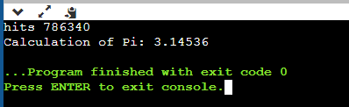


Now calculate $π$
Calculate $π$ based on the formula
$π$ = 4 x darts in the circle / total darts
Print out the value of $π$
Increase the number of darts to one million
You will want to comment out the printf for printing each dart’s X Y.
Is the value of $π$ more accurate?
public class Main{
public static void main (String[]args){
double x, y, pi;
int hits = 0;
int maxThrows = 1000000, dartThrow;
for (dartThrow = 0; dartThrow < maxThrows; dartThrow++){
x = (2 * Math.random ()) - 1;
y = (2 * Math.random ()) - 1;
if (Math.sqrt(Math.pow (x, 2) + Math.pow (y, 2)) <= 1.0){
hits++;
}
//System.out.printf ("dart at X %f Y %f\n", x, y);
}
System.out.printf(“hits %d \n", hits);
pi = (4 * ((double) (hits)) / maxThrows);
System.out.printf ("Calculation of Pi: %1.5f", pi);
}
}

